Slide 1
Options and Challenges for
Weathering and Corrosion Test Chambers for the Coating Industry from the view of a manufacturer
Dr. Andreas Giehl – European Technical and Standards Director
Q-Lab Deutschland GmbH
Notes:
Welcome to today’s webinar on the Essentials of Laboratory Weathering.

Slide 2
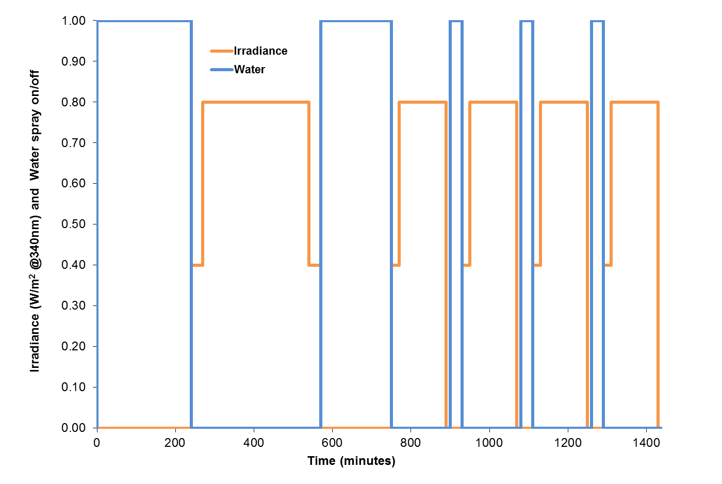
Where does ASTM D7869 come from?
One cycle per 24hrs

Slide 3
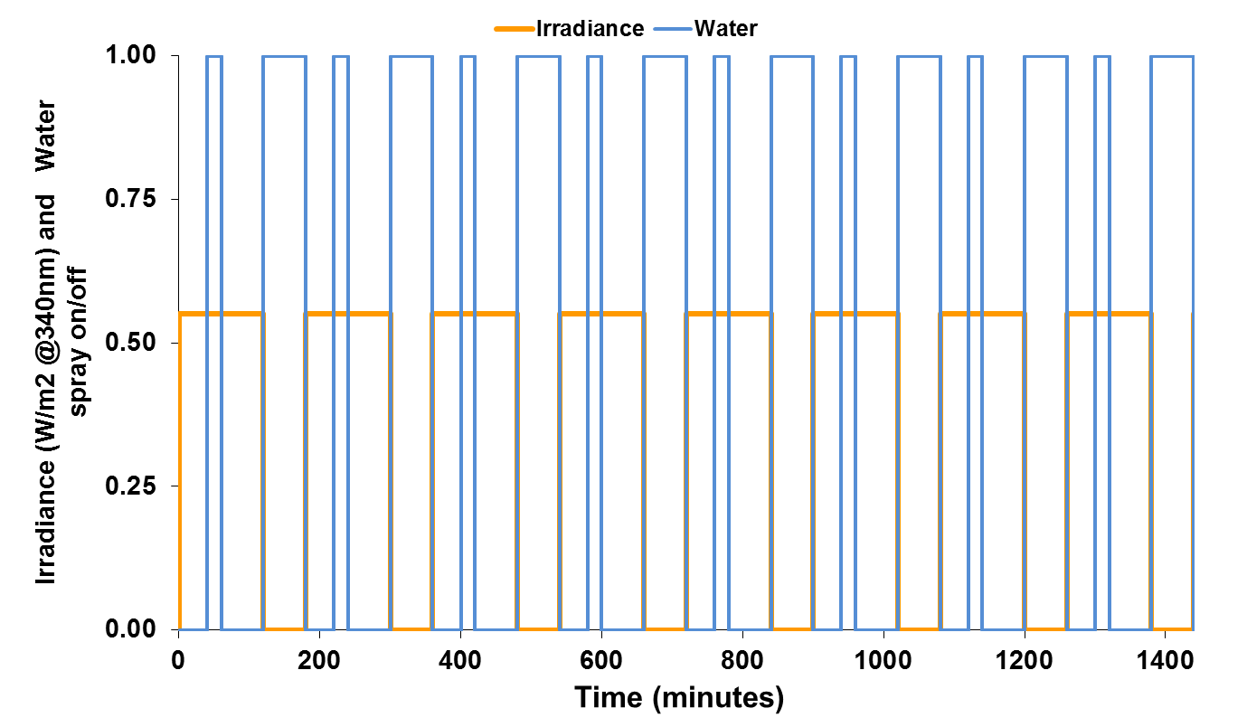
SAE J2527 Weathering Cycle
Light
Light+spray
Dark
Long water cycle
Short water cycle
8 cycles per 24hrs
(1 cycle per 3 hrs)

Slide 4
SAE J2527: benefits and fails
SAE J2527 = Performance Based Replacement for SAE J1960
Designed to Control Primary Stressors (Light, Humidity, Temperature) in Attempt to Replicate Gloss Loss and Color Fading Seen in Florida Exposures
SAE J2527 fails to predict other failures (blistering, cracking, delamination)

Slide 5
Water Absorption for Florida panel exposure
Radiation Intensity or Water Content (arbitrary units)
Day/night cycle (40hrs)

Slide 6
SAE J2527: What was missing
Samples outdoors are much longer wet than hot or irradiated
It rarely rains when the sun is shining (i.e. light+spray cycles are questionable)
Rain events during daytime rarely contribute to the water content of the samples
SAE J2527 does not include prolonged wet/dry periods
Amount of sprayed water not controlled

Slide 7
ASTM D7869 Weathering Cycle
Long dry/wet periods
Deep water penetration
Fully dry after light
Quick cycling, comparable to SAE J2527
High maximum irradiance level
30min „softstart“ irradiance
4hrs

Slide 8
ASTM D7869 Weathering Cycle
The mandatory sponge test gives full control on the amount of sprayed water. ASTM D7869 is the first weathering test protocol that defines a minimum amount for spray water delivery
ASTM D7869 = quick-cycling Xenon weathering test (SAE J2527) + slow-cycling Xenon weathering test (deep water penetration)
But why Xenon only?
The Xenon technology is the best simulation of the full sunshine spectrum (UV + Vis + IR)
UV is less than 5% of the global solar spectrum but causes 100% of the material degradation in terms of breaking chemical bonds (E = 1/λ)
UV Fluorescent technology is the best possible simulation of the UV part of the sunshine spectrum, more cost-effective, easier to maintain and well accepted since mid 1960´s.

Slide 9
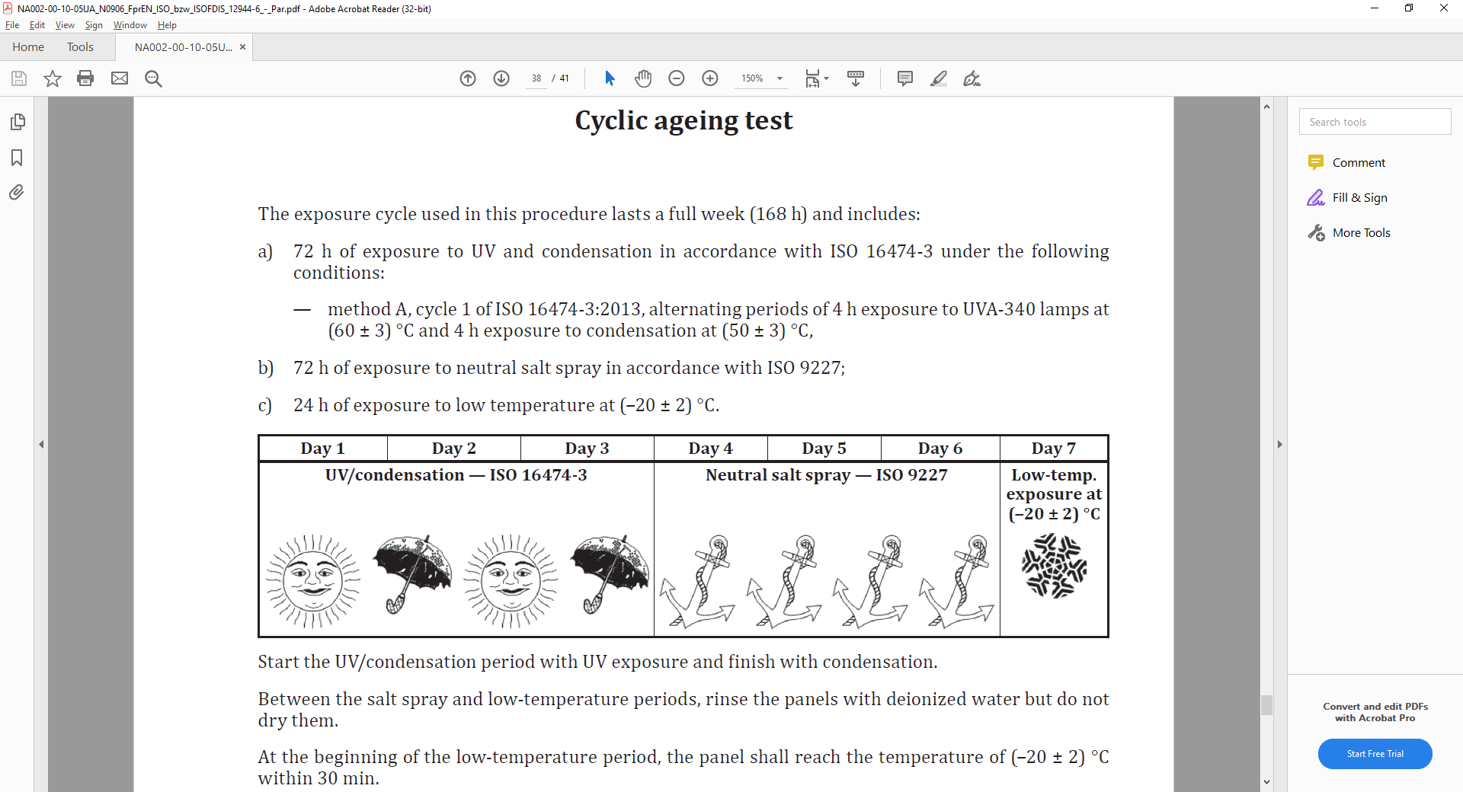
ISO 12944 weathering test (former ISO 20340)
Similar: ISO 11997-2 (protective steel coatings)
Alternating 1 week UV and 1 week Salt spray (no freeze)
1 cycle per week

Slide 10
ISO 12944: Benefits and Objectives
ISO 12944 is a series of test protocols designed to test protective coatings in a very corrosive environment
ISO 12944 is well accepted. People say that results are very consistent and allows service life prediction of the coatings very well.
ISO 12944 combines several well-known and accepted test protocols according to the different needs of the different corrosivity classes.
For the highest corrosovity class it combines a well-known standard UV fluorescent test cycle with well-known standard salt spray cycle and with a freezing step at -20°C
  UV fluorescent test cycle to damage and degrade the organic coating
  Salt spray cycle to start corrosion
  Freezing step at -20°C to create mechanical stress
What do ASTM D7869 and ISO 12944 have in common?

Slide 11
ISO 12944, Day 1-3
ISO 16474-3 Method A, cycle 1 is alternating periods of exposure to UVA fluorescent lamps at 60°C for 4 hrs, followed by continuos condensation (dark and very humid) at 50°C for another 4hrs
This cycle is very similar to ISO 4892-3 (8hrs UV + 4 hrs condensation) but coating manufacturers uncovered the importance of the condensation step over the prolonged UV exposure
Thus, the missing part of ASTM D7869 (deep water penetration) has always been included in all typical UV test protocols. For this, a full Xenon spectrum test is not necessary
3 cycles per day for 3 days

Slide 12
ISO 12944, Day 4-7
ISO 9227 is a very simple test protocol. A salt solution, atomizing nozzles and compressed air is used to create a highly corrosive environment which is permanently dark but humid.
After the humidity penetrated all accesible areas, the freezing step (Day 7) creates mechanical stress.
Overall, after 1 week of exposure the samples faced 1.5 days of UV light only, but 4.5 days of extremely high humidity and 1 day freezing.
ISO 9227-Neutral Salt Spray test is an old, very basic test without real „control“. It simply maintains humidity at very high level.
1 continous cycle for 3 days

Slide 13
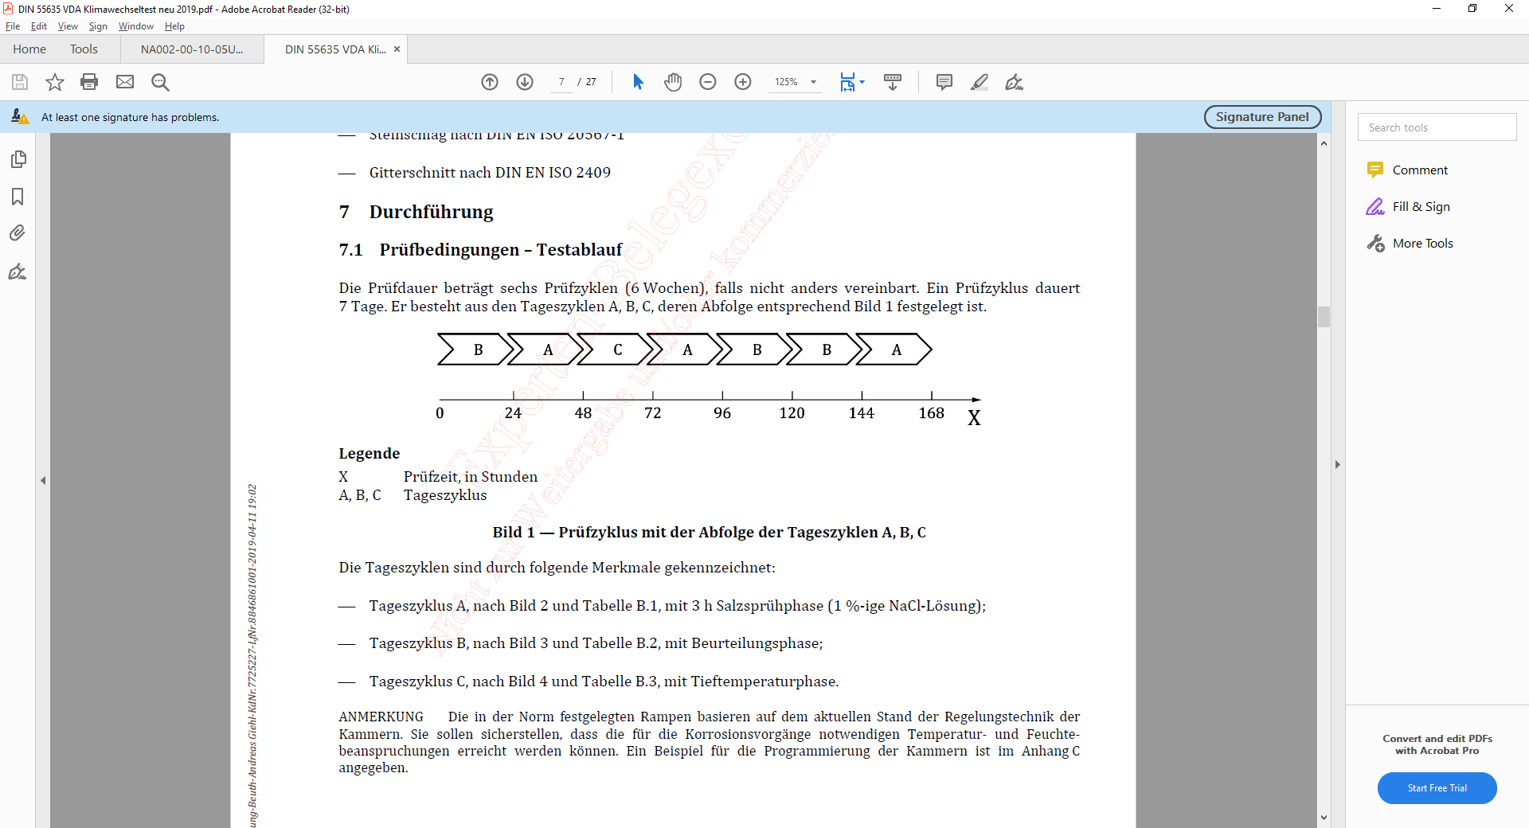
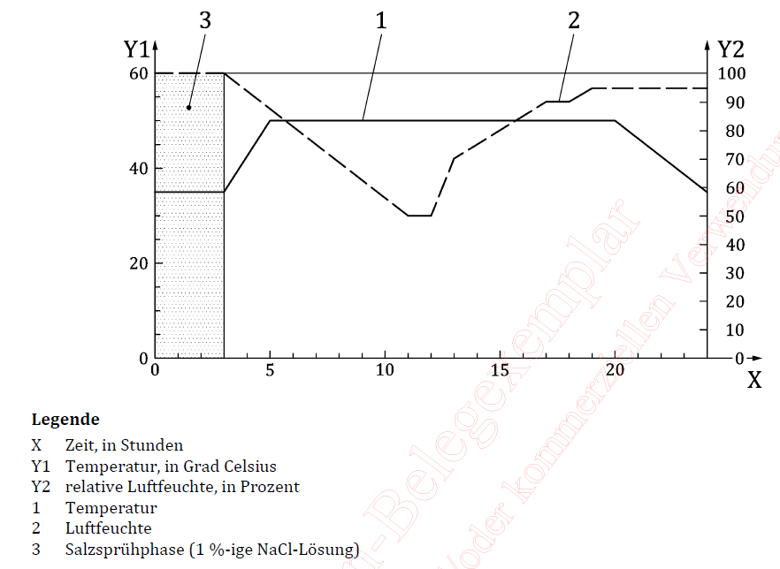
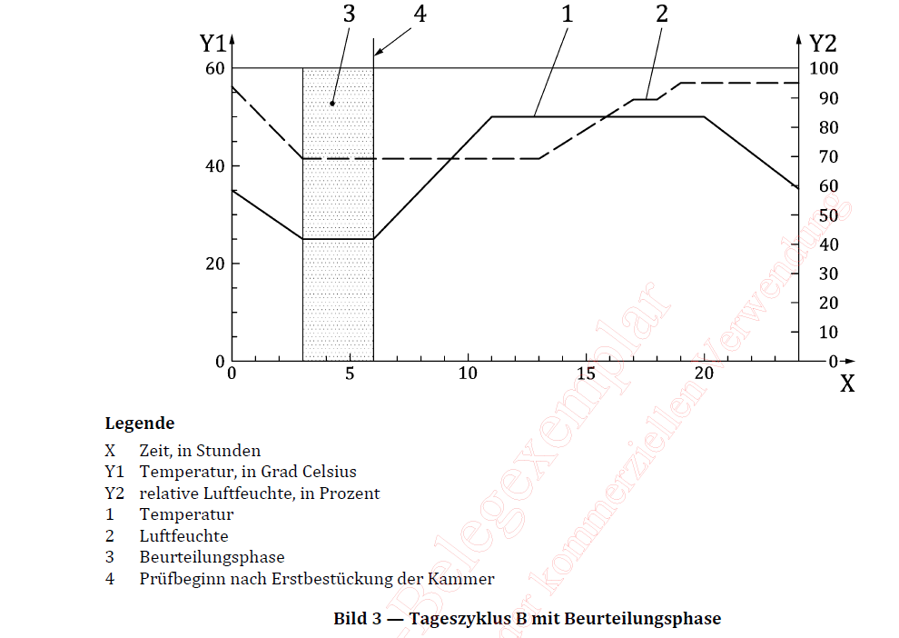
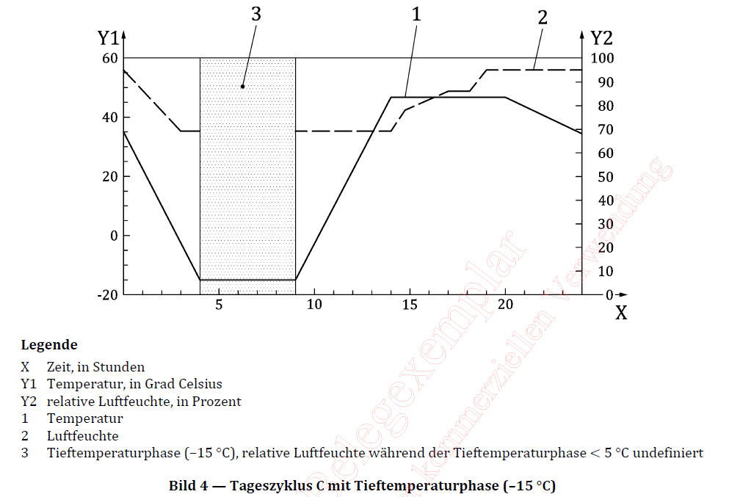
VDA “new” automotive test cycle
Y1=Temp
Y2=rH %
A
C
B
1 cycle per week with 3 different subcycles (24hrs)
Corrosion test only - no light step included
Extremly complex – very detailled definition of salt spray, humidity and temperature
One cycle per week
One subcycle per 24hrs

Slide 14
VDA corrosion test cycle – why so complex?
Because we can – modern equipment allows precise control
Ramps are the key to control the „Time of Wetness“
Time of Wetness has an influence on the results of both, corrosion and weathering tests. Thus, the Level of wetness must be controlled.
But beware „over-engineering“

Slide 15
Over-engineering

Slide 16
Over-engineering
All 25 data point can be replaced by 5 + tolerance

Slide 17
Options for Ramp/Transition Times
Linear
  Specify Time Controller adjusts temperature & RH for linear transition from beginning to end of ramp time
Less Than
  Specify TimeController attempts to achieve conditions within specified time

Slide 18
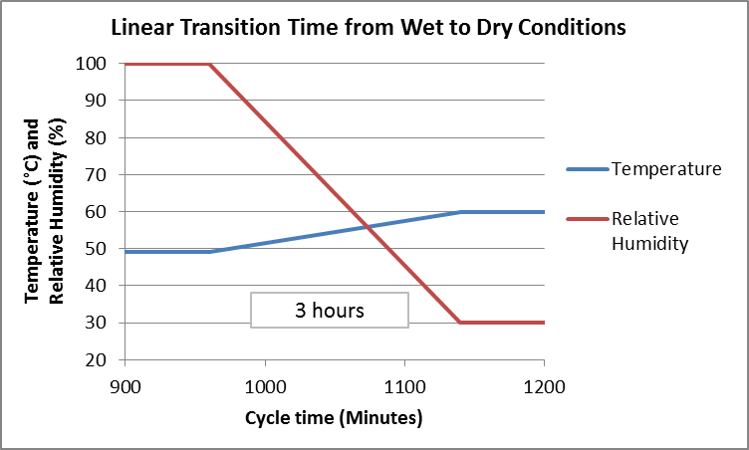
Linear Ramp Time

Slide 19
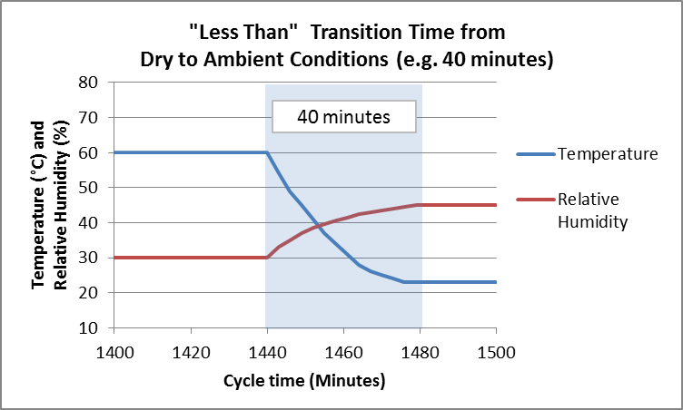
“Less Than” Ramp Time

Slide 20
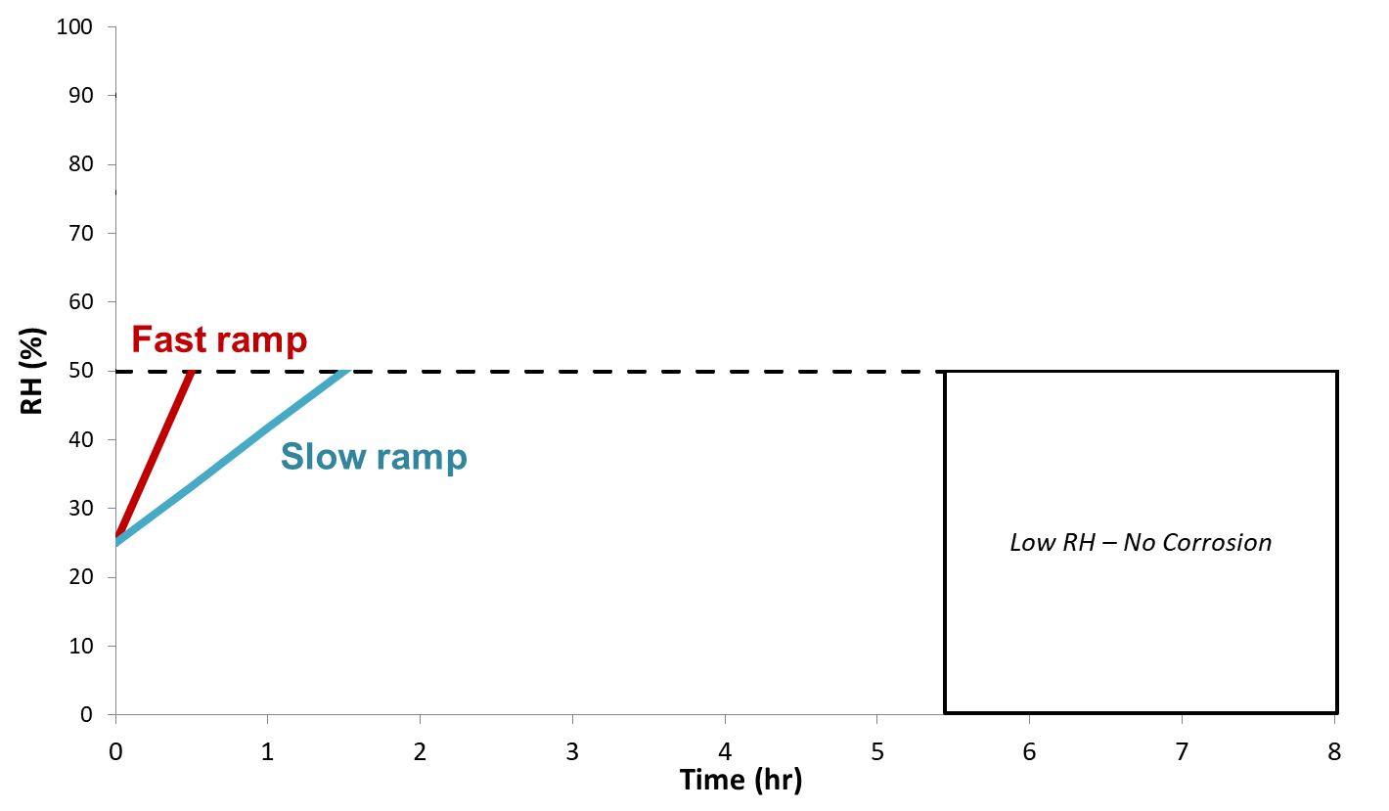
Corrosion during ramping
Low RH, <50%

Slide 21
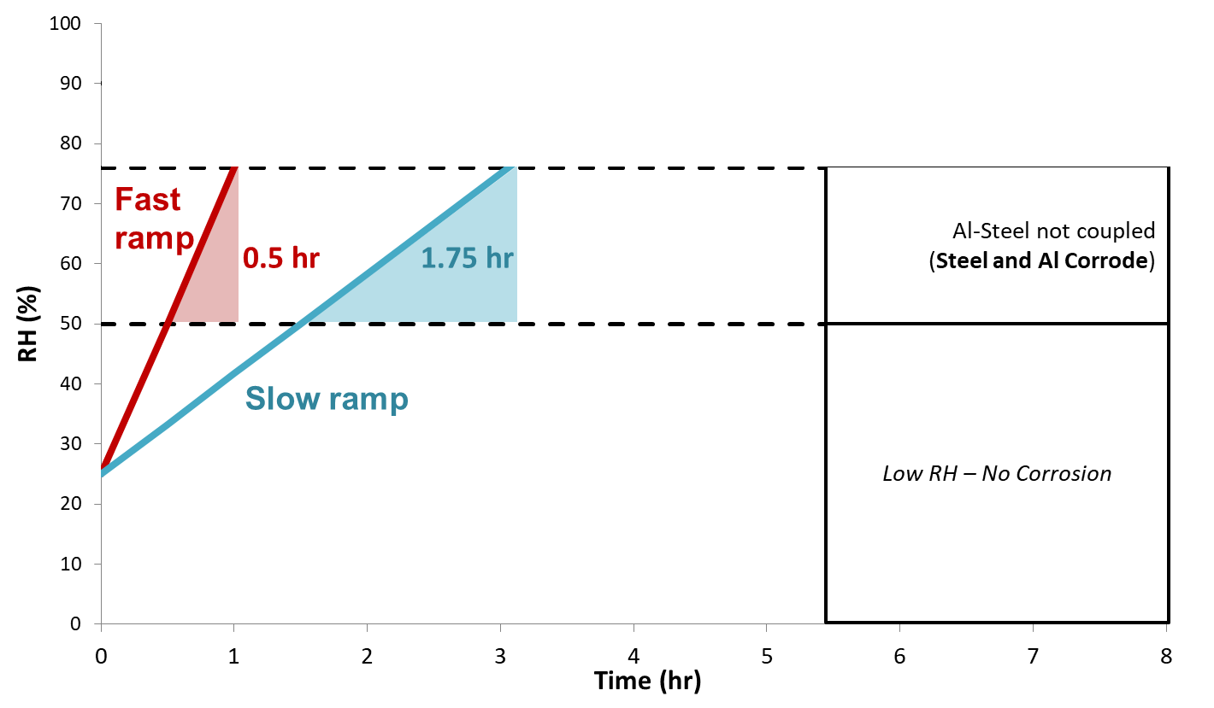
Corrosion during ramping
50% < RH < 76%

Slide 22
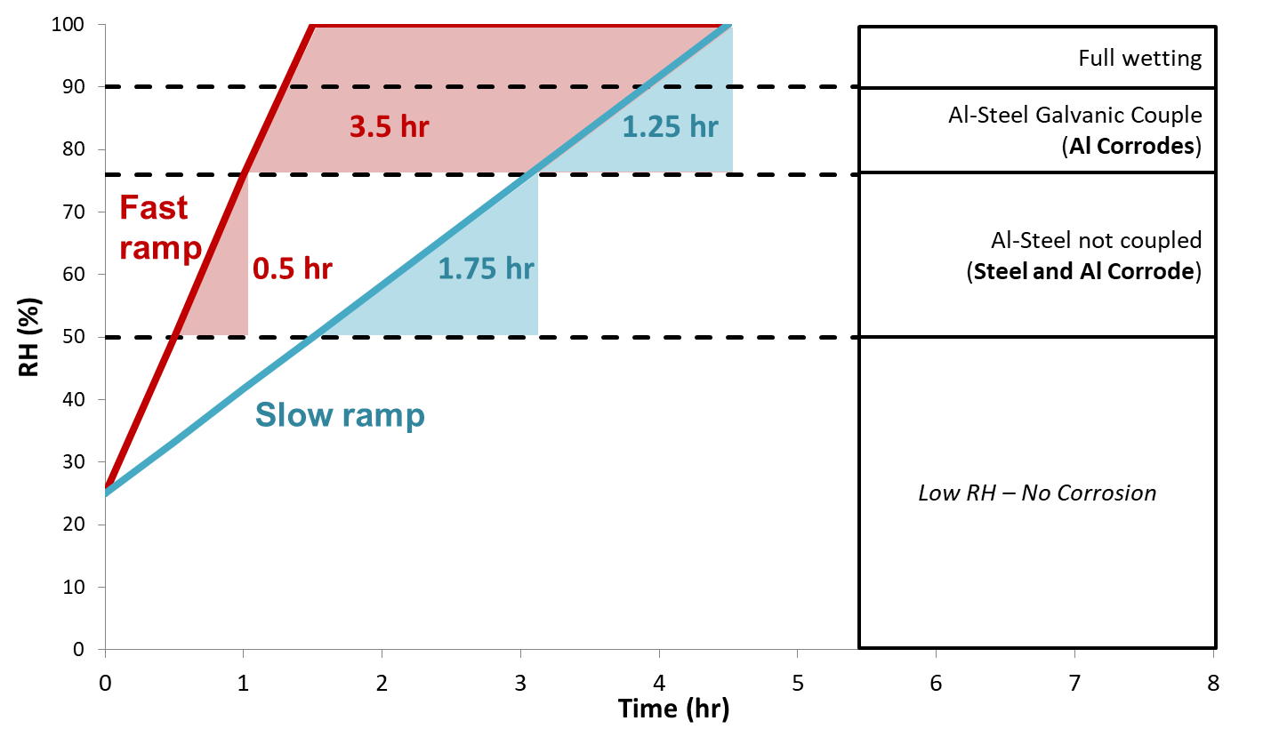
Corrosion during ramping
High RH > 76%

Slide 23
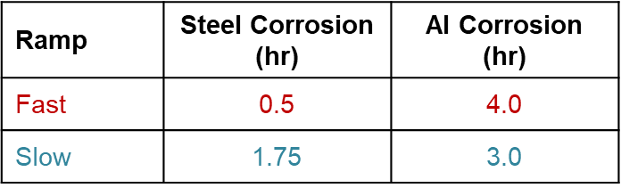
Corrosion during ramping
High RH > 76%

Slide 24
Uncontrolled BP Temperature during spray (Xenon)
BP temp setpoint: 63°C
18min spray
Continous light on
Uncontrolled temperature condition for 50 mins due to water temperature and heating performance of the tester

Slide 25
Uncontrolled BP Temperature during spray (Xenon)
BP temp setpoint: 63°C
18min spray
Continous light on
Uncontrolled temperature condition for 50 mins due to water temperature and heating performance of the tester

Slide 26
Uncontrolled transition - workaround
After spray cycle, the uncontrolled temperature raise is replaced by 5 defined steps

Slide 27
Why ASTM D7869 was a quantum step
Simple, quick-cycling light-and-spray test protocols do often have poor correlation with outdoor test results
Modern test cycle mimic outdoor experiences and therefore might take 24hrs or 7 days per cycle
Water is not simply water.
  Samples are much longer wet outdoors than expected
  Deep water penetration without light is crucial part of the degradation progress/degradation process
  Water might support migration, transportation, erosion…….
ASTM D7869 was the first Xenon test that controls amount of spray water delivery

Slide 28
Conclusion:
Simple salt spray cycles often do not correlate with outdoor results. Complex corrosion cycles need control of transition times.
Ramps are known to control complex effects in corrosion standards
Currently, no Xenon test protocol uses ramps. Workarounds are available but not in use.
Take as much control as possible on all parameters (e.g. sponge test) that affect your results. But do not over-engineer the cycle.
UV fluorescent devices might be a cost effective alternative to Xenon in test protocols for coatings and a valuable addition to corrosion test protocols that use salt spray only.

